Slide 1
TFS mFin Architecture Recommendation
Andrew Foster, Global Account Director
Syed Talha, Salesforce Program Advisor
Tim Sent, Master Enterprise Architect
Chris Hsu, Senior Program Architect
Phil Howard, Solutions Engineer
Updated October 22, 2019

Slide 2
TFS Objective: TFS is transforming itself from being just a Financial Services company to being a digital and mobility company. As a digital company, TFS is looking to expand into Business Process Outsourcing (BPO) for other Captive Finance Companies ranging in any size (mFin).
In preparation for this transformation, TFS has requested that Salesforce recommend an Org Strategy that will support its primary stated goals:
Sell services in a reusable way from the highest to the lowest level business process.
Have a subscription model that can be tailored to each customer by feature.
Build Partnerships with vendors
Partner with SaaS vendors to use their technology to support the business value chain.
Leverage out-of-the-box capabilities first.
Have technology and design in alignment to mFin architecture such that this can be scalable for use for any future customers across any channels and any size.

Slide 3




mFin Servicing Solution Approach
Sales Cloud
Service Cloud
Platform
Communities
A lightweight component and event-driven architecture design with OOTB utilization
Capability | Salesforce Cloud | Salesforce Features
Standard Sales & Servicing Capabilities |  | Console, LWC, Events, Standard Taxonomy, Case Management, Opportunity Management
Support for Multiple Private Labels |  | Divisions, Entitlements, other OOTB record and process access controls
Internationalization Support |  | OOTB multi currency, multi language, internationalization design elements, and localize data residency support, custom business rule endpoint configuration setup
Application Distribution |  | Jump Start packaged deployment in international instances
Maximum Web Self-Serviceability | TFS Stack OR | Use TFS platform of choice or natively enable Web Self-Service through Salesforce Communities
Data Archiving by design | TFS Stack | Enable Data Archiving from the day one to keep the system in tip top condition

Slide 4
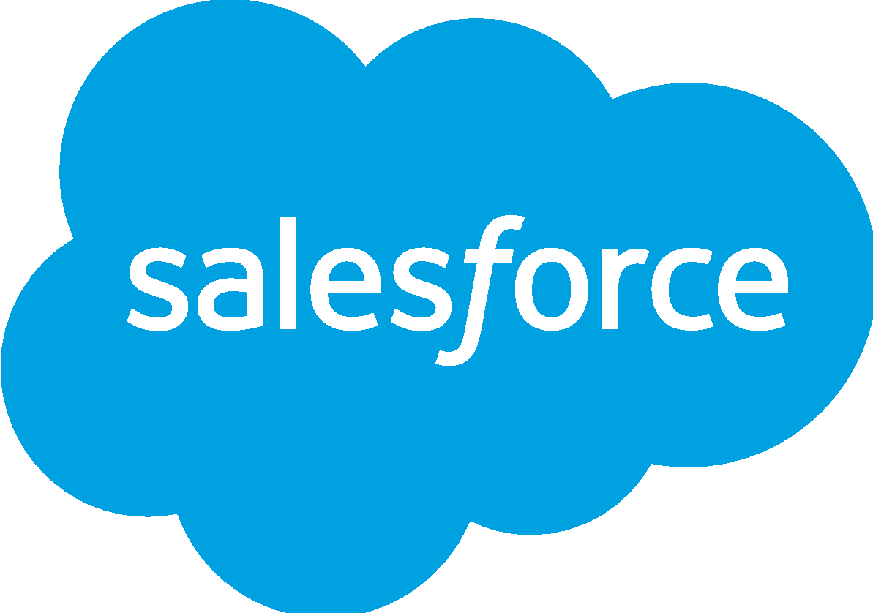
Org Recommendation
Provides agility and scalability to line of business from B2C vs. B2B2C perspectives
Provides necessary compliance protections to international expansion
Provides private label business expansion flexibility for F&I Servicing, Sales, or all inclusive operations
Supports organic transition to modern architecture and dealing with tech debt without additional investments
United States Sales and Service Operations Stack
INS Servicing
FIN Servicing
SRM
Agreement and Claims servicing functions
mFinance servicing functions
Dealer and Objectives management
EU Operations Stack
UK Operations Stack
JP Operations Stack
4

Slide 5
Risks
mFin API functionality and availability can impact the delivery and complexity of Salesforce solution
Lack of focus, coordination, alignment on the solution, and priorities between factories can affect the overall delivery of the solution.
The delivery team’s relevant experience and skills can positively or negatively impact delivery velocity.

Slide 6
Private Label Service Agent Enablement Candidate Roadmap
 | Release 0 - [6 Weeks] | Release 1 - [16 weeks] | Release 2 [4 weeks]
Scope | Planning & Alignment Business capabilities prioritization Standardized process taxonomy definition Design and release alignment between Business, API, Salesforce, and Telephony workstreams Data archiving approach Define success metrics for the program | Foundational The foundational Servicing data model Data security & sharing model to support TFS multi-customer servicing needs Foundational Salesforce event-driven architecture blueprint Integration pattern selection framework CTI Lightning console framework and componentization of release 1 servicing capabilities | Sprint - Build & Deploy Necessary data model changes Business function component build Applicable Salesforce configuration changes Case workflow development Business Rule API integration
Outcomes | Business & technology capability roadmap and success metrics for at least the next three releases Standardized process taxonomy for at least the next three releases A framework to define the separation of concerns between Salesforce and mFin business rules API An efficient decision making operating model between cross-functional teams | Release 1 go live Foundation is ready to support monthly sprints | Sprint go live

Slide 7
APPENDIX / REFERENCE MATERIALS

Slide 8
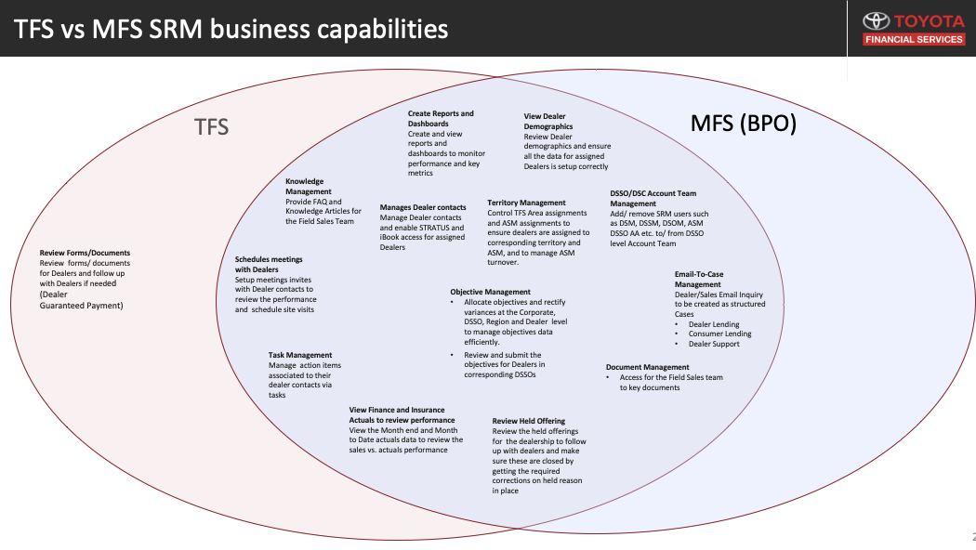

Slide 9




Data Center Locations FY19 - FY22
Salesforce Data Center
(20)
(20)
(22)
(16)
(15)
Commerce Cloud
(41)
(33)
(21)
(12)
(0)
Marketing Cloud
(6)
(6)
(6)
(3)
(0)
(6)
(6)
(7)
(8)
Public Cloud*
(8)
Year End: FY19 FY20 FY21 FY22
*Map Excludes Public Cloud sites with spend <$1m annual spend & PoP Locations
Notes:
First view: Represents our current footprint of 67 data centers and two public cloud deployments
On Click: By the end of FY19 we will decom 8 Commerce Cloud sites, and two core salesforce facilities. We will also add two Cloud Scale Facilities to Northern Virginia
On Click: FY20 will reduce the Commerce Cloud footprint by another 12 sites and 4 core facilities (SFM, CHI, WAS, WAC). We are also planning to add a public cloud region in Singapore, two colocation facilities in Japan, and small Cloud scale facilities in Paris and Frankfurt.
On Click: Marketing cloud will begin transition in FY21 by exiting three facilities in Canada, Commerce cloud will exit 9 more facilities, and core will exit 6 facilities (PHX, DFW, IAD, CH4, FRF, PAR). Growth will continue with a second cloud scale region on the west coast of the US and another public cloud launch in India
On Click: FY22 will complete the commerce cloud, marketing cloud, and Core migrations to deliver a consolidated portfolio across 15 facilities and four public cloud regions
Other AWS Regions: California, Ireland, Frankfurt, Singapore, Ohio, Japan, UK, India, Brazil, South Korea, France

Slide 11
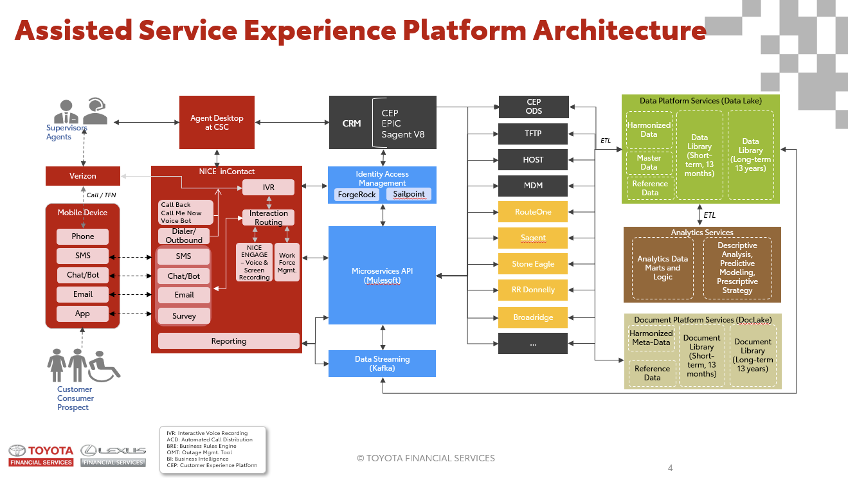

Slide 12
